Slide 1
Virtual Cloud Storage
We reduce the cost of storing, protecting and accessing
compliance and high-value data in the cloud, up to 80%

Slide 2
Global Storage Facts
GLOBAL STORAGE MARKET
Data Growth: 50+% / yr
Prices Falling: 5-10% / yr
Cloud growing at 15% CAGR
80% is unstructured data
Files (PDF, XLS, Doc…) not databases
80% of that data is inactive
Not used in 12 month or more
Cloud Storage
15% CAGR
Sales in Billions
2021
2026
Sources Include: IDC Data Age Report sponsored by SeaGate

Slide 3
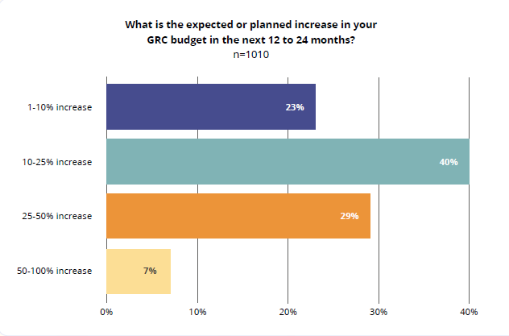
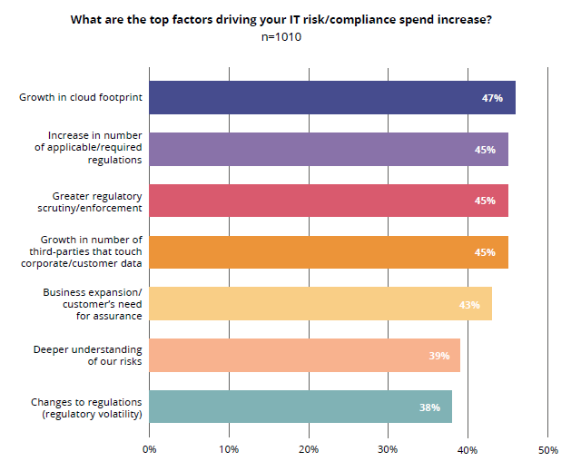
2023 Compliance trends next 12-24 months
63% expect increased spending
Average 25% increase in spending
Source: https://hyperproof.io/it-compliance-benchmarks/

Slide 4
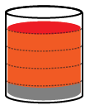
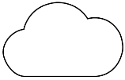
Storage challenges facing ECM customers
CAPTURE
DELIVER
$
$
$
$
$
STORE
MANAGE
BACKUP
TRAINING
DEVOPS
SharePoint
PRESERVE
80% of data is inactive
Local storage being wasted
Cloud copies very expensive

Slide 5
How does restorVault assure ECM compliance with 80% lower costs?

Slide 6
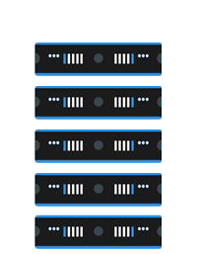
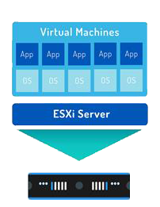
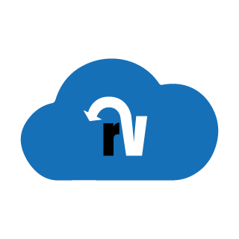
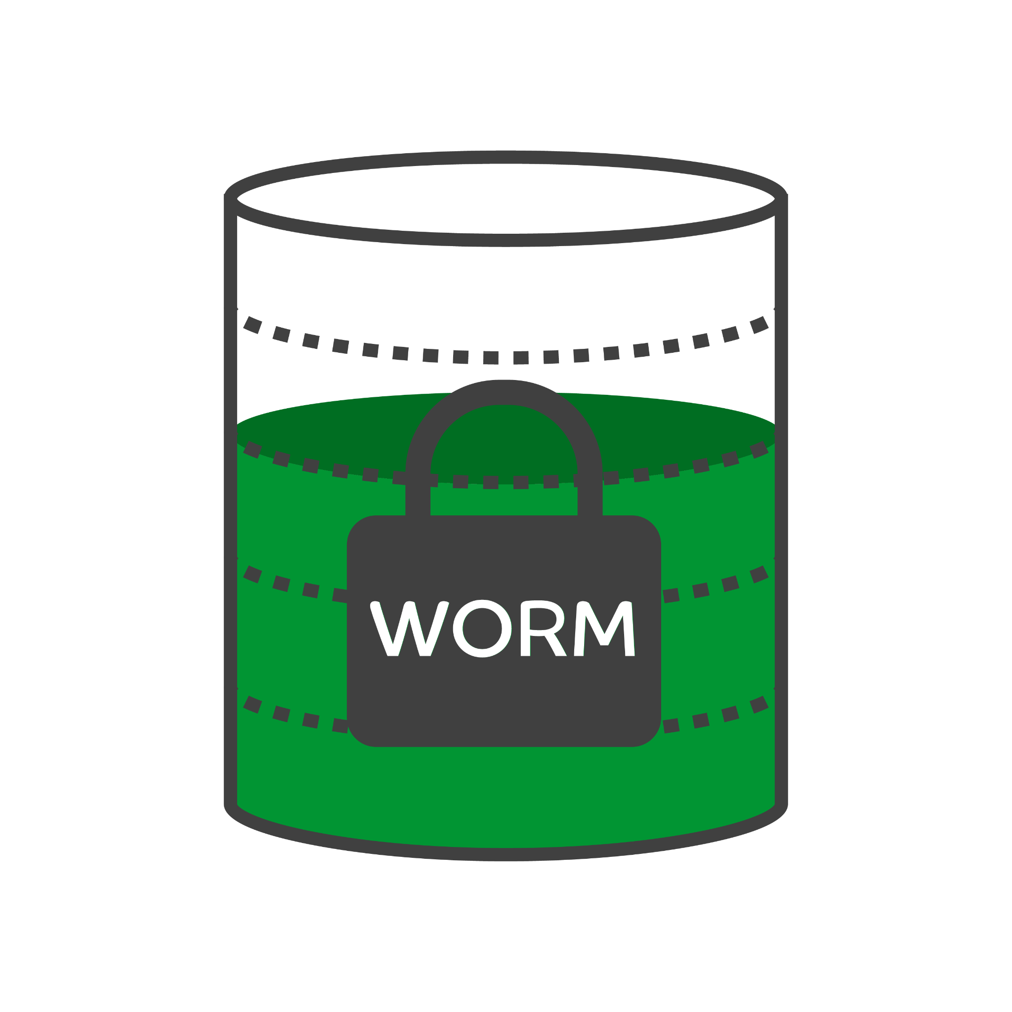
New approach: Data Virtualization
Vmware: Virtualized OS
restorVault: Virtualized Data
Virtual Data Files
PRIMARY
eDISCOVERY
PRIMARY
DR
SharePoint
DR
ARCHIVE
LOCAL
BACKUP
OFFSITE
BACKUP
Trusted Storage
Under utilized
servers
VMware Virtual
Server
80% storage wasted
on inactive data
ASSUREON VAULT FOR
STORAGE, ARCHIVE & DR

Slide 7
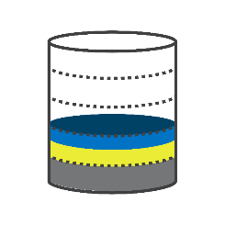
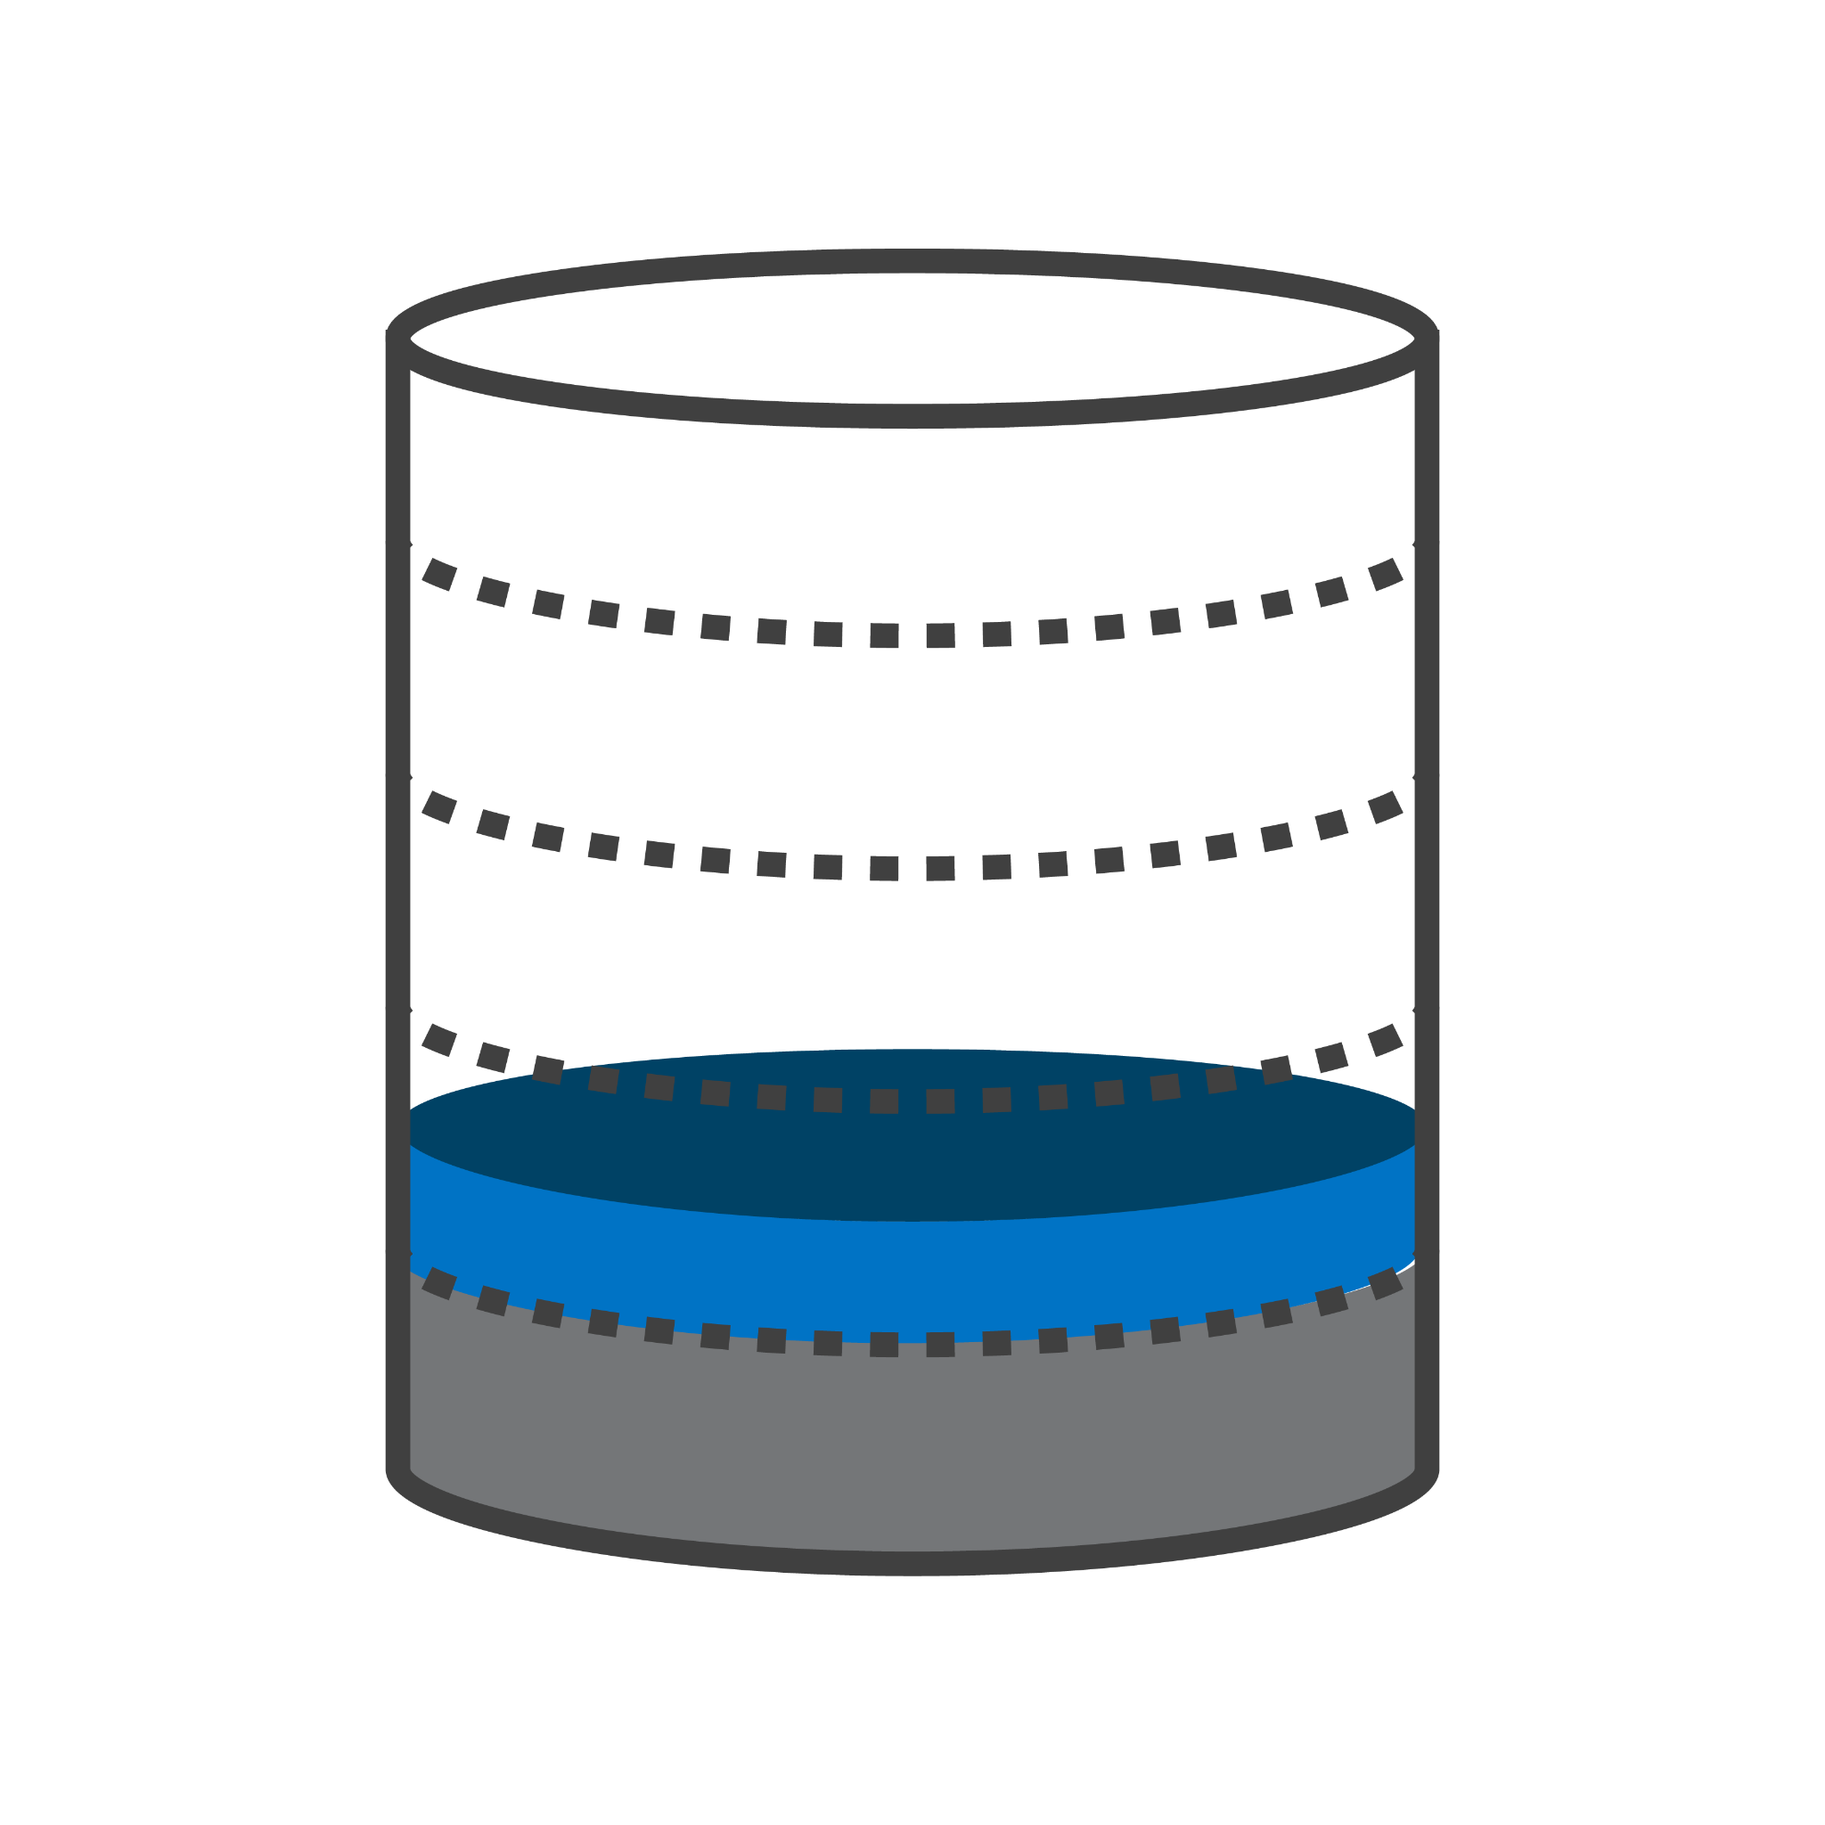
restorVault Virtual Cloud Storage
Trusted Storage
Redundant, WORM object storage
Two copies, separate data centers
Data encrypted in-flight and at rest
Verified/audited data integrity
Trusted Systems compliant
Virtualized Access *
Offload Data Virtualization
Reduces storage/backup/DR ~80%
Copy Data Virtualization
Reduces multi-cloud storage ~90%
Virtual Data File Recovery
Restores TBs of file access in minutes
Trusted Storage
Storage, Archive and DR in one
PRIMARY
DR
SharePoint
Virtualized Access
* US Patent 11,630,737

Slide 8
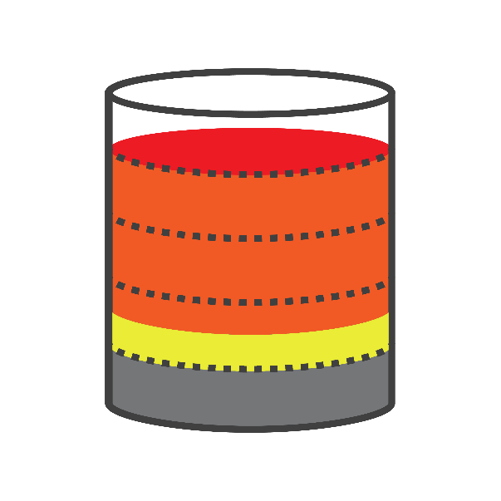
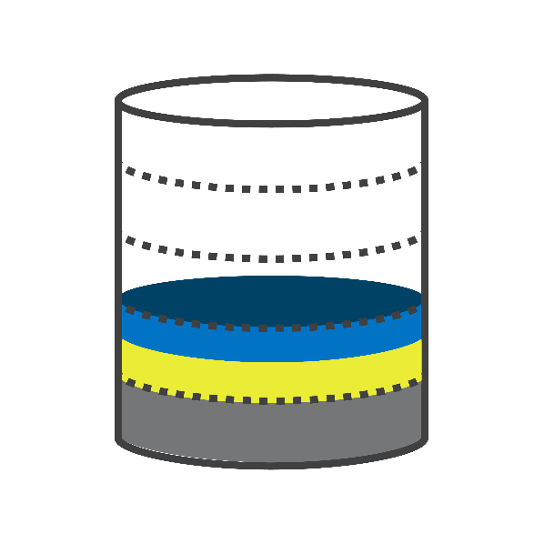
The Inactive Data Problem
CURRENT SITUATION
TRUSTED CLOUD STORAGE
80%
INACTIVE
80%
INACTIVE
80%
INACTIVE
VDF
VDF
VDF
ACTIVE
ACTIVE
ACTIVE
ACTIVE
ACTIVE
ACTIVE
O/S
O/S
O/S
O/S
O/S
O/S
PRIMARY
STORAGE
LOCAL
BACKUP
CLOUD
BACKUP
SMALLER BACKUP
Virtual restore of VDFs in mins
Full restore in 1/5th the time
Reduces recovery downtime
TAMPERPROOF
& REDUNDANT
TRUSTED VAULT
Designed for compliance
Hash, fingerprint, time…
Data integrity assurance
Immune to ransomware
Safer than the original
What if you could put your files into a tamperproof multi-cloud vault and always trust the gold copy? Then you would only need to backup bookmarks to inactive files!
CAPACITY RECLAIMED
Delays storage CAPEX for years
Avoids hassle & OPEX of upgrades
Cloud Backup savings, pay for it!
Notes:
According to Source 80% of Enterprise data is inactive
And Data is growing 60% per year
So now you take a local backup
And a remote or cloud backup
Copying all that inactive data

Slide 9
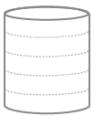
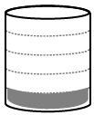
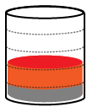
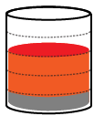
Public Cloud Storage OS, Db and Data ghosted to the Cloud
ON PREM / PRODUCTION
CLOUD BUSINESS OPERATIONS
DR
PROVIDER 1
BACKUP SOFTWARE
DevOps
SharePoint
PROVIDER 2
OS
Db
Data
Notes:
This is an Opex heavy model.
In this deployment model you ghost entire servers to the cloud, where you rent compute and storage.
But if 80% of your data is mostly inactive unstructured data, every time you replicate the data for different use cases, such as training and disaster recovery, you are duplicating the static data again and again which us highly wasteful of capacity.
So long as you trust it is impossible to alter, damage or erase an image, how many copies of it do you REALLY need?
Over time, the Opex is high and tends to grow, because the growth in data outstrips the fall in storage prices.

Slide 10
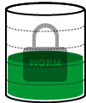
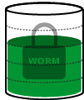
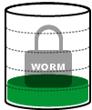
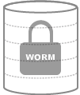
Public Cloud Storage with restorVault OS, Db and Active Data ghosted to the Cloud, unstructured data moved to rV
ON PREM / PRODUCTION
CLOUD BUSINESS OPERATIONS
DR
PROVIDER 1
PROVIDER 1
BACKUP SOFTWARE
DevOps
SharePoint
PROVIDER 2
FSW POLICY
MANAGER
CCA / SCB
OS
Db
Data
Protected Data
VDF

Slide 11
restorVault – Compliance Assured
Trusted Systems compliant storage
Immutable storage, Impervious to ransomware
Assured data integrity with redundant copy
500x faster recovery and copy data
Lightweight Virtual Data Files not data copies
Restores 800 VDFs / sec vs 5-10 files / sec
Restore or spin up new server copy in mins
Up to 80% lower storage costs
Frees up capacity on primary and cloud servers
No data recovery or lock-in fees from rV
1 GB
HOW IS
THIS →
1 TB
BETTER
THAN
THIS →
PROVIDER 1

Slide 12
Traditional vs Trusted Systems storage
Unprotected storage: Files can be edited & deleted without trace.
Protected, audited storage:
Files can never be altered and may only be deleted per h/w enforced retention policies.
No file protection:
Permissions: ALL
Added file protection:
Permissions: WORM
+ Fingerprint
+ Time stamped
+ Auto verified
+ Serial numbered
+ Duplicated
+ Audit trail
+ VDF
Trusted
Systems
Compliant
$0.12/Gb
$0.15/Gb
Vulnerable File System: Ransomware attacks file systems, so this backup can also be attacked.
No File System
Object storage which is impervious to ransomware
DUPLICATE IN
REDUNDANT
DATA CENTER
Notes:
How is your Cloud “backup” safer in our Vaults?

Slide 13
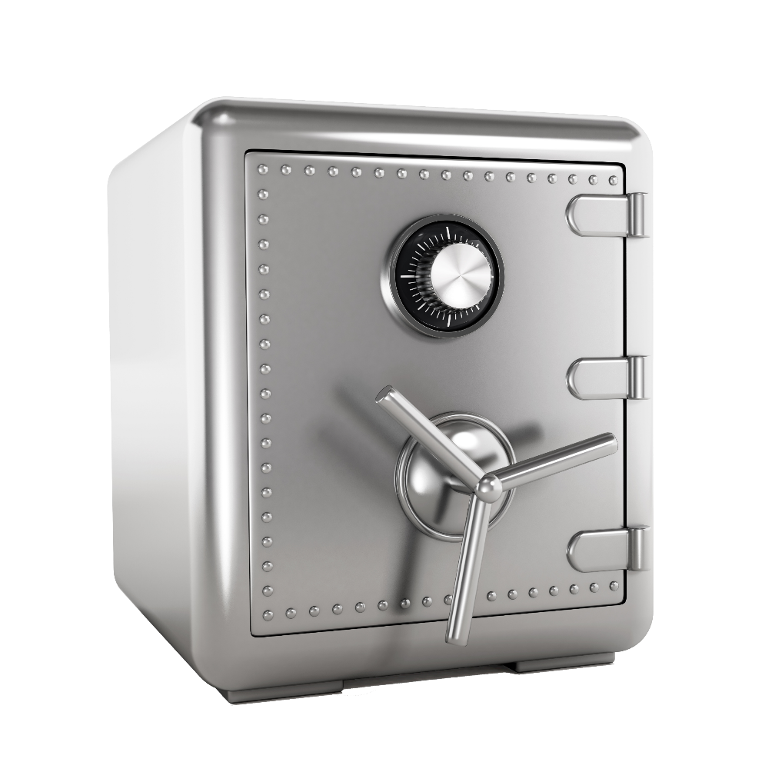
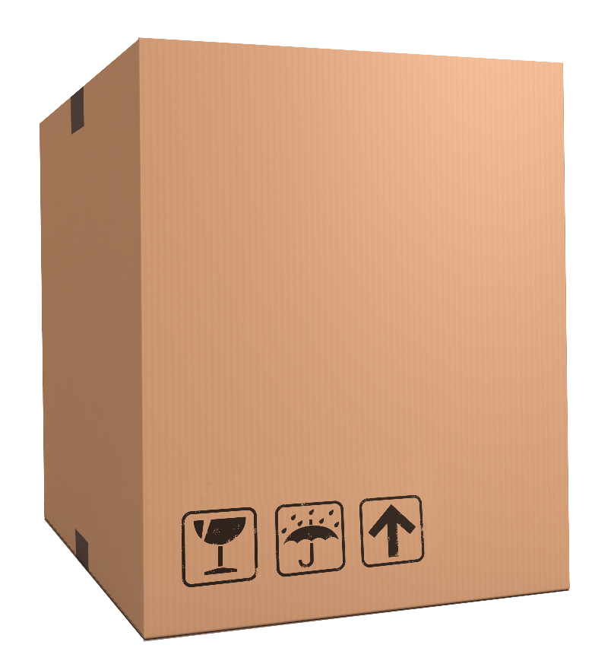
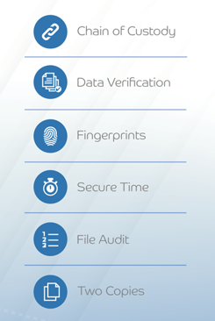
restorVault – Assured Data Integrity
PRIVATE
TRADITIONAL CLOUD STORAGE
TRUSTED CLOUD VAULT

Slide 14
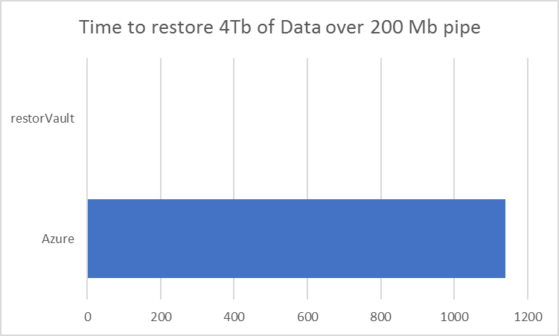
Fast virtual recovery and copy data
4 Tb unstructured data locked-out by ransomware attack
Total of 800,000 files restored, with average file size of 5 Mb
DataCenter Bandwidth | Conventional Cloud Backup and Restore | With restorVault
50 Mbps | 10,800 mins | 8.5 mins
200 Mbps | 1,410 mins | 2.2 mins
TWO MINUTES
TWO DAYS
Over 500x faster even with big internet connections
Notes:
As we mentioned earlier, Availability has to do with how quickly after a failure or ransomware attack a company’s data can be restored from a backup and the system can return to full operation.
Having a backup is great, but if it takes forever to restore it to the primary server, a company can still be severely compromised and suffer enormous reputational and lost opportunity costs. Security magazine estimated the average downtime costs of a ransomware attack for companies at $141,000 in 2019.
Let’s take a typical example… a company that has 4 Terabytes of unstructured data – say roughly 800,000 files of 5 MBytes each. And let’s assume they have a cloud backup of all that data, but then they suffer a primary server failure or ransomware attack. They’re protected, because they have the backup, but they now have to download that entire 4 Terabytes of data over their internet connection.
If they have a typical 50 mega bits per second connection, it will actually take OVER 7 DAYS to re-download all that data! And during that time they are effectively off-line and non-operational.
Even if the company has a high speed connection of 200 mega bits per second, it will still take ALMOST 2 FULL DAYS to download the data.
These are not just arbitrary examples. There are cases reported in the news with some frequency where companies have taken multiple days to up to a full week of more to restore operations following an attack.
By comparison, with restorVault, the restore process involves downloading the much smaller Virual Data Files or VDFs, and as soon as they are all downloaded, the system is again operational. For the above example, a restore under a restorVault system can be accomplished in a matter of minutes.
RestorVault reduces restore and recovery times by 500 to 1000x, helping get businesses back up and running without significant delay, and saving them the many costs of multi-day downtime.

Slide 15
Two Stages of Recovery
Stage 1 - Virtual Recovery
Stage 2 - Full Recovery
All data in CCA or TCS vault is accessible, via VDFs restored to the server.
This takes minutes or hours.
800K files / minute
All active data plus VDFs for all inactive data have been restored to the server.
This takes ~25% of previous time.
Depends on file size and broadband

Slide 16
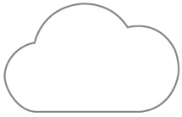
restorVault simplifies multi-cloud access
COMPLEX / NOT DEFAULT
REQUIRES ADDITIONAL SOFTWARE ABSTRACTIONS
PRIVATE
PRIVATE

Slide 17
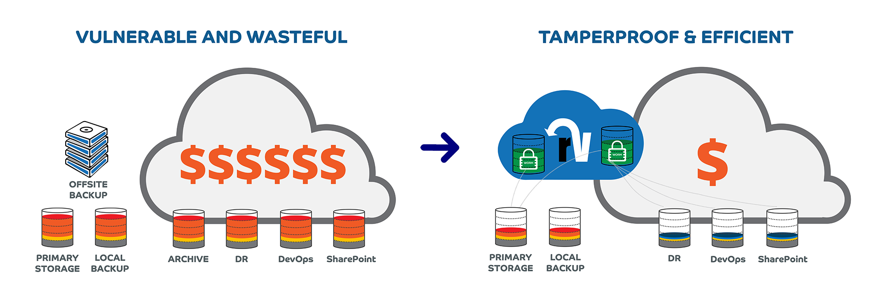
Virtual Cloud Storage changes the paradigm
Unverified copy data integrity
All files vulnerable to Ransomware
80% of files on server are inactive
100% data duplication in the cloud
Two verified, trusted gold copies
Immutable WORM object storage
Uses 80% less server and backup capacity
Uses 90% less multi-cloud capacity

Slide 18
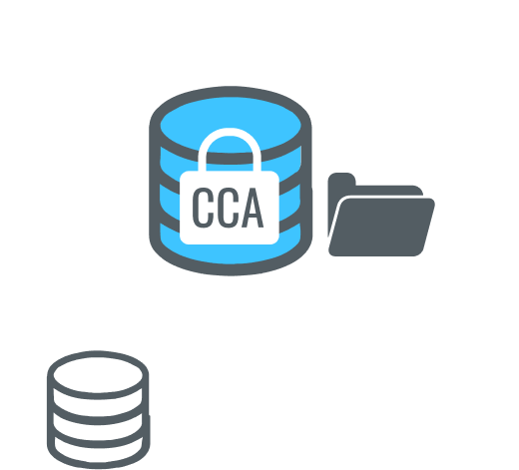
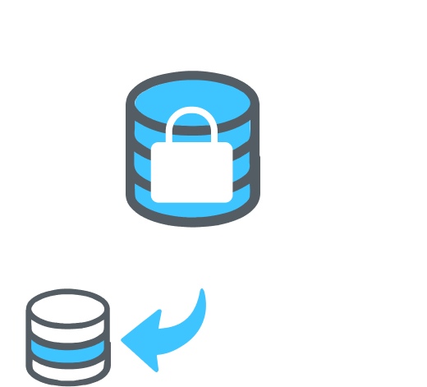
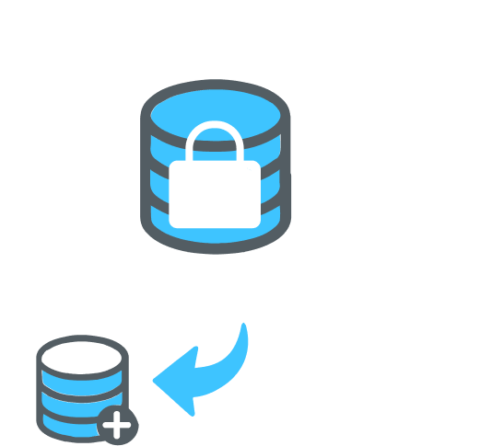
Virtual Cloud Storage Use Cases
TRUSTED STORAGE
VIRTUALIZED ACCESS
Compliant Cloud Archive
Tamperproof Cloud Storage
Offload Data Virtualization
Copy Data Virtualization
Long-term cloud archive
for long-retention and retrieval of compliance data, that may not be altered.
Daily sync with 30 day versions for high-value unstructured data backup with complete disaster recovery in mins.
Free-up primary storage by virtualizing inactive data retained and protected in a CCA or SCB vault.
Access CCA/TCS copy data for business functions such as Q/A, Dev, Training, DR, without using more storage
Superior protection and faster recovery
Capacity savings driving 80% lower costs

Slide 19
Cloud Storage Comparison
 | ON-PREMISE STORAGE | CONVENTIONAL CLOUD | CLOUD with RESTORVAULT
CAPITAL COST | HIGH | NONE | NONE
OPERATING COST | LOW | HIGH | LOW
COPY DATA COST | HIGH | HIGH | LOW
DATA LOCK-IN FEES | NO | YES | NO
RANSOMWARE IMMUNITY | NO | NO | YES

Slide 20
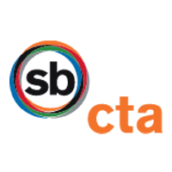
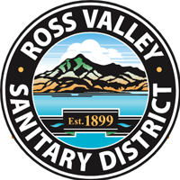
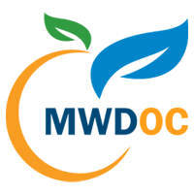
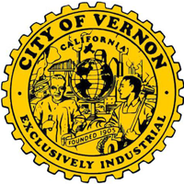
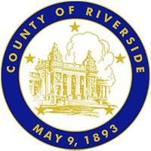
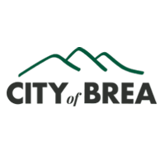
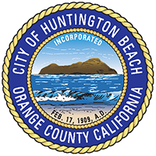
State & local agencies using restorVault

Slide 21
Example IT Storage Savings
Server Disk Space Analyzed
wh-ch-files01: 4.29TB
wh-ch-fndapp: 574.83GB
pd-whi-files01: 1.56TB
Total Analyzed Capacity: 6.43TB
<365 Day Active Data Cap/%
wh-ch-files01: 530.00GB/12%
wh-ch-fndapp: 149.11GB/26%
pd-whi-files01 : 380.00GB/24%
Total Active Capacity: 1.06TB/16%
>365 Day Inactive Data Savings Cap/%
wh-ch-files01: 3.76TB/88%
wh-ch-fndapp: 425.72GB/74%
pd-whi-files01: 1.18TB/76%
Total Inactive Data: 5.37TB/84%
Total Server/Backup/DR Savings: 16.10TB
TOTAL DISK
CAPACITY 7.2TB
PRIMARY
1.06TB
5.37TB
LOCAL BACKUP
1.06TB
5.37TB
OFFSITE BACKUP
1.06TB
5.37TB

Slide 22
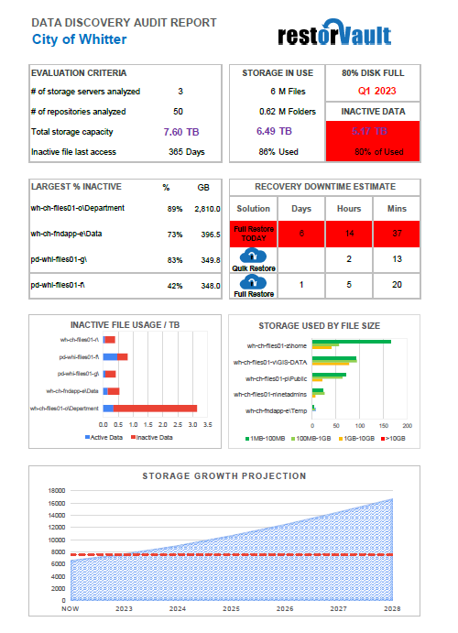
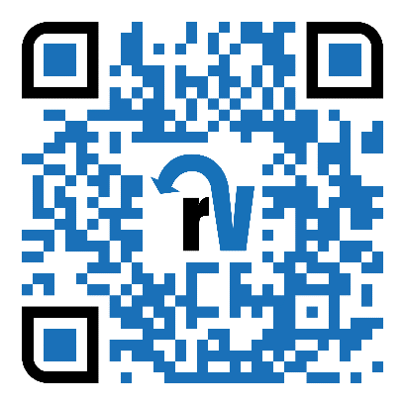
Free Data Discovery audit
Analyze data usage on servers
Up to 10 Folders or 5 Servers
Ratio of active versus inactive
File distribution by file size
Recovery downtime estimates
Data growth & disk full forecast
Folders with most inactive files
Reclaimable storage capacity
Request Data Discovery

Slide 23
SPARE SLIDES
More Details / Other Points

Slide 24
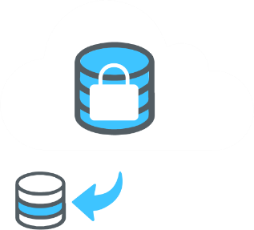
Expanding the Opportunity
ECM TEAM
IT & OTHER DEPTS
Security, Finance, Others
Includes ODV primary offload
Includes ODV primary offload
Upsell CDV for cloud copies
BENEFITS:
RECLAIM
PRIMARY
CAPACITY
Upsell CDV for cloud copies
BENEFITS:
TRUSTED SYS
PROTECTED
FASTER DR
BENEFITS:
VIRTUAL
CAPACITY

Slide 25
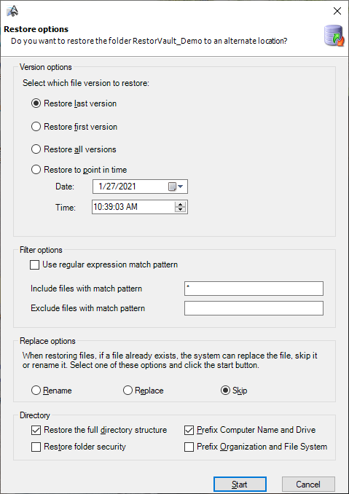
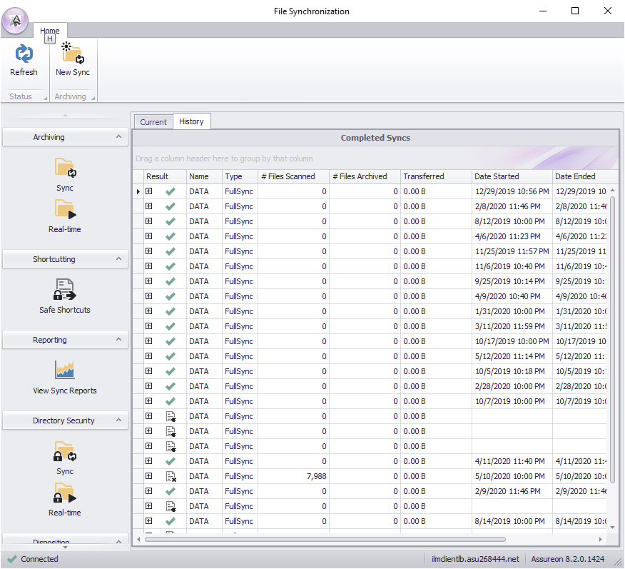
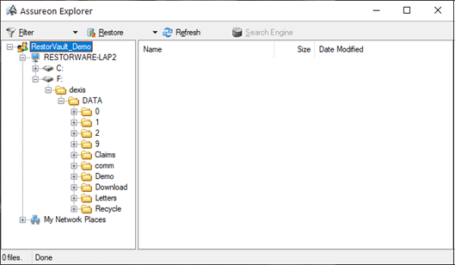
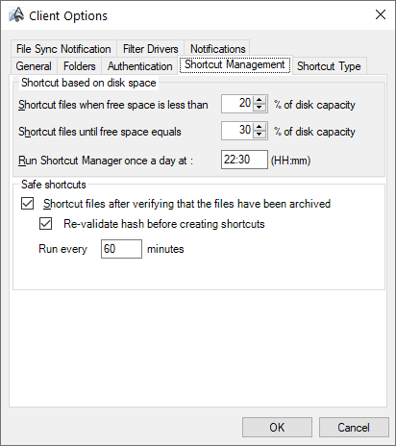
restorVault FSW and Policy Manager
Notes:
Describe the software components
File System Watch
Assureon Sync
Assureon Explorer
See what files exist on the volume and restore any item
Policy Manager
SPEAK TO THE TAB FUNCTION in the Client options screen
Backup or not backup
Identical copy of original in backup
Virtualize or not virtualize
Original is now a VDF
Schedule timing and frequency or on-demand

Slide 26
ECM Base Example with restorVault CCA
Items | ECM with Local Storage | ECM with restorVault
ECM User Licenses | $55,000 | $55,000
Storage (Trusted) | $35,000 | $5,000
Scanners | $5,000 | $5,000
Services | $5,000 | $5,000
Budget Total | $100,000 | $70,000
LOWER-UP FRONT CAPITAL INVESTMENT – SHIFTS CAPEX to OPEX
Notes:
Here we see a customer who has an ECM and storage budget of $100K.
By converting the storage requirement from a CapEx expense of 35K to an OpEx expense of only 5K using CCA, $30,000 is freed up .
This found money can be used for additional ECM licenses or equipment purchases. Or alternatively, a customer who couldn’t proceed because they didn’t have the full 100K budget, may be able to move forward with the new cost savings of 30K.
Either way, it represents income to you that might otherwise not have been achievable.

Slide 27
Upsell Case Study – California Municipality
Initial Sale: Compliant Cloud Archive
Laserfiche ECM CA Trusted System
1TB of ECM data: $2,360 / yr
Upsell 1: Offload Data Virtualization
Offload up to 1TB: $360 / yr
Avoid primary storage upgrades
Upsell 2: Copy Data Virtualization
3 copies 1TB CCA: $1,800 / yr
Net savings > $4,000 over AWS etc.
Follow-on Sale: Secure Cloud Backup
5TB of Windows file data: $3,140 /yr
80TB of video surveillance: $37,600 /yr
Total Follow-on deal: $40,740 /yr
LOW HANGING FRUIT – ECM INSTALED BASE
They flip cloud storage to restorVault and lower storage bill 40-50% overnight.
You lock-in annual recurring revenue
Notes:
So let’s look at an actual case that demonstrates how an initial modest CCA sale grew into a significant contract and opportunity for a restorVault reseller.
An initial entry level sale of CCA was made to a California municipality for 1 Terabyte of Laserfiche ECM storage. The deal was worth about 2400 dollars, and we worked with the IT director and his team to get it installed.
After learning the advantages of restorVault and seeing the cost savings, they began to explore the possibility and value of moving other high value data they maintained across to the restorVault VCS product.
The net result was an 85 Terabyte VCS sale !!! that had a value of over 40 thousand dollars a year, all because of an initial couple thousand dollar deal. And there is still the potential for additional VDR follow-on sales for their Copy Data requirements.
So we believe, based on actual experience, that restorVault can help you close sales you might otherwise have lost based on cost, and that we can help you roll up initial CCA sales into some very significant revenue opportunities.
…pause…
And now, I’d like to explain the actual structure and details of our reseller program, and then look at some possible next steps.

Slide 28
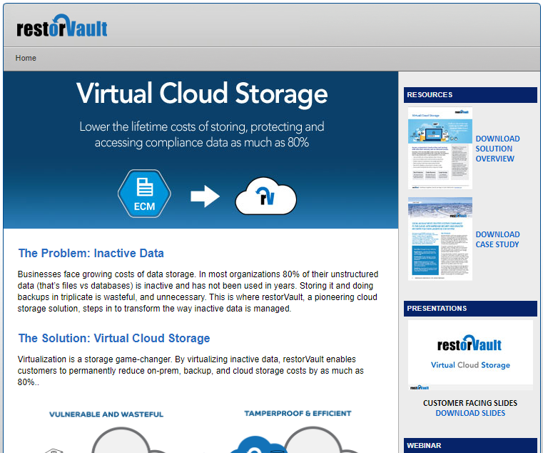
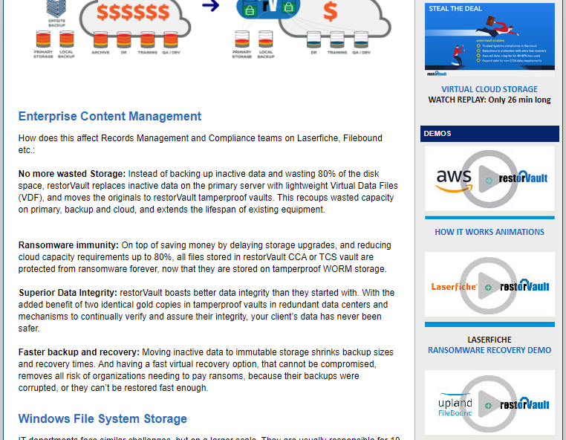
Tools and Resources Available
PARTNER PAGE
Available Today:
Solution overview flyer
Sales slides and icon library
Today’s webinar recording
Disaster recovery demo videos
How it works animations MP4
Web animations embed code
Coming soon:
Cloud storage ROI calculator
Virtual storage sales guide
Generic case studies
LIVE SALES SUPPORT
We want to help you with
Backup on sales calls
Client-facing webinars
Case study writing

Slide 29
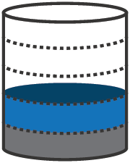
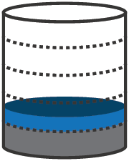
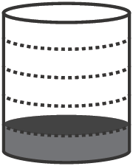
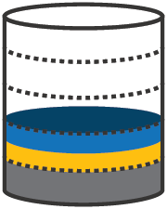
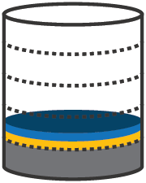
VECTOR Cylinders

Slide 30
restorVault redundant data centers
We maintain a redundant copy of all data in our network
Cross verified, Auto corrected, Fingerprinted,
How is client data protected from unauthorized access?
ARLINGTON, VA
Iron Mountain
SAN DIEGO, CA
ScaleMetrix
PHOENIX, AZ
Iron Mountain

